Slide 1
Metabolism of Xenobiotics Introduction of xenobiotics Biotransformation Cytochrome P450 phase I and Phase II reactions Biomedical importance of xenobiotics Dr. Pawan Kumar Kare Demonstrator Department of Medical Biochemistry GMC, Bhopal.

Slide 2
Xenobiotics/Detoxification/Biotransformation
(Gk Xenos means "stranger“
(any foreign substance which the body does not recognize)
biotics = metabolism
Xenobiotics means metabolism of foreign molecules/compounds.
Also called- Detoxification
(conversion of toxic substances to less toxic molecules).
Also called- Biotransformation
(because not every time toxic molecules converted to the less toxic it may be converted to the less toxic molecules to more toxic molecules.

Slide 3
Types of Xenobiotics
Exogenous-
The foreign molecules which gain entry through dietary food stuffs, or in the form of certain medicines/ drugs used for a therapeutic cause or are inhaled through environment .
Examples: Drugs, food additives, pollutants, insecticides, etc.

Slide 4
Endogenous-
These are synthesized in the body or are produced as metabolites of various processes in the body.
Examples: Bilirubin, Bile acids, Steroids, Eicosanoids and certain fatty acids.

Slide 5
Purpose of Biotransformation
1. facilitates excretion: Converts lipophilic to
hydrophilic compounds
2.Detoxification/inactivation: converts chemicals to less toxic forms
3. Metabolic activation: converts inactive drug to its active form

Slide 6
Metabolism of Xenobiotics
Detoxification Reactions
All the biochemical reactions, involved in the conversion of foreign, toxic and water insoluble molecules to non toxic, water soluble and excretable forms are called Detoxification / Biotransformation reactions.
Metabolism of xenobiotics occurs in two phases-
Phase I & Phase II
The overall purpose of the two phases (phase I & phase II) of metabolism of xenobiotics is to increase their water solubility (polarity) and thus excretion from the body.

Slide 7
Phase I : Phase 1 reactions converts xenobiotics from inactive to biologically active and/or more toxic to less toxic compounds.
The major reactions involved are oxidation, reduction and hydroxylation. In addition to these, a wide range of reactions also take place during phase I-
Deamination
Dehalogenation
Desulfuration
Epoxidation
Peroxygenation
Notes:
PHASE 1 FOR TO CONVERT MOLECULES LITTLE LESS TOXIC FORM AND PHASE 2 PERPOSE IS TO CONVERT MOLECULES MORE WATER SOLBULE POLAR TO EXREATE FROM BODY. FIRST PHASE 1 REACTION TAKES PLACE

Slide 8
Phase 2 (Conjugation reactions): Phase 2/conjugation reactions converts active products of phase 1 reactions to less active or inactive species and/or converts molecules to water soluble & polar in nature, which are subsequently easily excreted in the urine or bile.
The compounds produced in phase 1 are converted by specific enzymes to various polar metabolites by conjugation with- (4G M SAT)
Glucuronic acid
Glycine
Glutamine
Glutathione
Methylation
Sulfation
Acetylation
Thiosulfation

Slide 9
Sites of detoxification/biotransformation
Liver
Primary site! Rich in enzymes
Hepatocytes contain wide variety of enzymes to process xenobiotics
Acts on endogenous and exogenous compounds
Extra-hepatic metabolism sites
Intestinal wall
Sulfate conjugation
Esterase and lipases - important in pro-drug metabolism
Lungs, kidney, placenta, brain, skin, adrenal glands
Notes:
Subcellular Locations of Metabolizing Enzymes
ENDOPLASMIC RETICULUM (microsomes): the primary location
(a) Phase I: cytochrome P450, flavin-containing monooxygenase, aldehydeoxidase, carboxylesterase, epoxide hydrolase, prostaglandin synthase, esterase.
(b) Phase II uridine diphosphate-glucuronosyltransferase, glutathione S-transferase, amino acid conjugating enzymes.
CYTOSOL : many water-soluble enzymes.
(a) Phase I: alcohol dehydrogenase, aldehyde reductase, aldehyde dehydrogenase, epoxide hydrolase, esterase
(b) Phase II: sulfotransferase, glutathione S-transferase, N-acetyl transferase, catechol 0-methyl transferase, amino acid conjugating enzymes
MITOCHONDRIA
(a) Phase I: monoamine oxidase, aldehyde dehydrogenase, cytochrome P450
(b) Phase II: N-acetyl transferase, amino acid conjugating enzymes
LYSOSOMES :Phase I: peptidase.
NUCLEUS: Phase II: uridine diphosphate-glucuronosyltransferase (nuclear membrane of enterocytes)

Slide 10
Xenobiotic-Metabolizing Enzymes (XME)
Phase I enzymes:
Cytochrome P₄₅₀
Flavin Containing Monooxygenase
Epoxide Hydrolase
Alcohol /Aldehyde Dehydrogenases
Monoamine Oxidases
Xanthine oxidase
Phase II enzymes: “Transferases”
Sulfotransferases (ST)
UDP-glucuronosyltransferases (UGT)
Glutathione S-transferases (GST)

Slide 11
Cytochrome P₄₅₀
Most of the oxidation reaction of detoxification are catalysed by monoxygenese or cytochrome P450. The P450 refers to the absorption peak of this enzyme at 450 nm, when it is exposed to the Carbon monoxide (CO).
Multiple forms of Cyt. P450 are available ranging from 20 to 200.
They are all hemoproteins, containing heme as the prosthetic group.
It is found in the highest concentration in the microsomes of liver. The mechanism of action of Cyt. P450 is complex and is dependent on NADPH.

Slide 12
PHASE I REACTIONS

Slide 13
1. Oxidation
A large number of foreign compounds are detoxified by oxidation.
Example of compounds: Alcohols, Aldehydes, Amines, Aromatic hydrocarbons and sulfur compounds etc.
Ethanol
Acetic acid
Benzaldehyde
Benzoic acid
Aniline
p- Amino phenol
Benzene
Phenol
Organic sulfur
Sulfuric acid
Notes:
Chloral ------------------------------trichlroacetic acid (TCA)

Slide 14
2. Reduction
The following are the reactions of detoxification by reduction.
Example of compounds: Picric acid, Chloral, Nitrobenzene etc.
Picric acid
Picramic acid
Chloral
Trichloroethanol
Nitrobenzene
Aminobenzene

Slide 15
3. Hydrolytic Reactions
The hydrolysis of the bonds such as ester, glycoside and amide is important in the metabolism of xenobiotics.
Example of compounds: Aspirin, Acetanilide, Atropine etc.
Esterase
H₂O
Salicylic acid
Acetic acid
Acetylsalicylic Acid
(Aspirin)
Notes:
Acetanilide ------------------------aniline + acetic acid Atropine --------------------tropic acid

Slide 16
PHASE II REACTIONS
(CONJUGATION REACTIONS)
Notes:
4GMSAT

Slide 17
1. Glucuronidation
Conjugation with glucuronic acid is most frequent conjugation reaction.
UDP-glucuronic acid (UDPGA) is the glucuronyl donor and active form.
UDP-glucuronyl transferases (UGT), present in both the endoplasmic reticulum(ER) and cytosol, are the catalysts.
Compounds such as 2-acetylaminofluorene (a carcinogen), aniline, benzoic acid, meprobamate (a tranquilizer), phenol, bilirubin and many steroids are excreted as glucuronides.

Slide 18
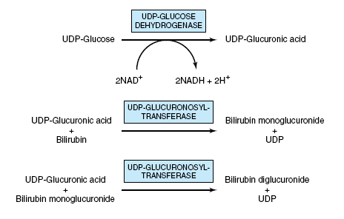
Glucuronidation of bilirubin
Notes:
UDP Glucoronic acid is product of uronic pathway

Slide 19
2. Conjugation with Glycine
• Example: Glycine conjugated with Cholic acid, Benzoyl CoA and form Glycocholic acid and hippuric acid.
Cholic acid + Glycine
Glycocholic acid
Benzoyl CoA
+
Glycine
Hippuric acid
Notes:
Other metabolites of aspirin cholic acid +glycine =
the acyl glucuronide conjugate of salicylic acid (salicylic acid glucuronide)
the phenol glucuronide conjugate of salicylic acid (salicyl phenol glucuronide)
the ring hydroxylated product of salicylic acid (gentisic acid)
the ring hydroxylated product of the glycine conjugate (gentisuric acid

Slide 20
3. Conjugation with Glutamine
• Example: Glutamine conjugated with Phenyl acetic acid and form Phenylacetylglutamine .
Phenyl acetic acid + Glutamine
Phenylacetylglutamine is excreted in phenylketonuria (PKU) patients urine.
Phenylacetylglutamine
Notes:
Other metabolites of aspirin cholic acid +glycine =
the acyl glucuronide conjugate of salicylic acid (salicylic acid glucuronide)
the phenol glucuronide conjugate of salicylic acid (salicyl phenol glucuronide)
the ring hydroxylated product of salicylic acid (gentisic acid)
the ring hydroxylated product of the glycine conjugate (gentisuric acid

Slide 21
4. Conjugation with Glutathione
Glutathione (γ-glutamyl-cysteinylglycine) is a tripeptide consisting of glutamic acid, cysteine, and glycine (G-C-G).
Cysteine part of the glutathione is very important in the detoxification process.
R-cysteine + aromatic compound N-acetyl transferase
Mercapturic acid
Notes:
Glutathione – three functions
• Reduction- antioxidant (glutathione peroxidase)
• Conjugation -(glutathione transferase)
• AA Transport into cells -(glutamyltransferase, GMT)
A number of potentially toxic electrophilic xenobiotics (such as certain carcinogens) are conjugated to the nucleophilic GSH
The enzymes catalyzing these reactions are called glutathione S transferases and are present in high amounts in liver cytosol and in lower amounts in other tissues

Slide 22
5. Methylation
Enzyme: methyltransferases
S-adenosylmethionine (SAM) is methyl donor for methylation of certain xenobiotics.
Methyltransferase
S-adenosylmethionine
+
X-OH
S-adenosylhomocysteine
+
XO-CH₃

Slide 23
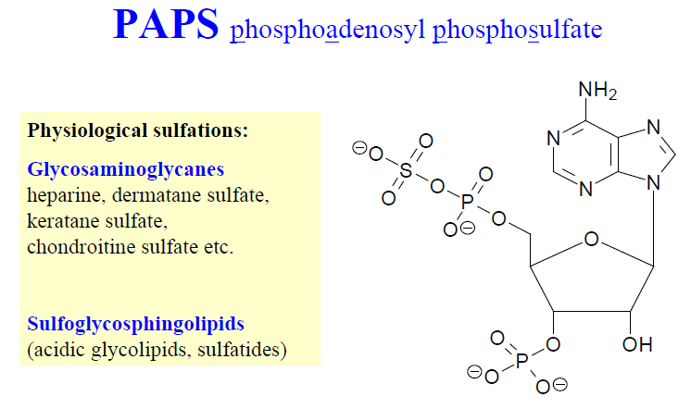
6. Sulfation
Compounds such as alcohols, arylamines, and phenols are sulfated. Other biologic sulfation reactions are sulfation of steroids, glycosaminoglycans, glycolipids, and glycoproteins.
The sulfate donor is “adenosine 3-phosphate-5-phosphosulfate” (PAPS)- Active form of sulfate.
Sulfotransferase
Phospho-adenosyl-phosphate (PAP)
Phenol
PAPS
Phenyl Sulfate
+
+

Slide 24
7. Acetylation
Acetyl CoA (Active acetate) is the active form of acetic acid. That takes part in conjugation.
The drug isoniazid and sulfanilamide are converted to acetyl derivatives.
Sulfanilamide
+
Acetyl CoA
Acetyl Sulfanilamide + CoASH
isoniazid Acetyl isoniazid
Notes:
Acetyl Isoniazid sulfanilamide antibacterial drug

Slide 25
8. Thiosulfation
Conversion of cyanide to thiocyanate.
Cyanide
Thiosulfate
+
Thiocyanate + Sodium sulfate

Slide 26
Biomedical importance
Humans are subjected to exposure to various foreign chemicals; xenobiotics. Knowledge of the metabolism of these xenobiotics is helpful in understanding of-
Pharmacology and therapeutics of drugs
Toxicological studies of compounds
Management of various diseases

Slide 27
Thank you

Slide 28
Factors affecting biotransformation of drugs
Prior administration of the drug or Co-administration of other drugs
Diet
Hormonal status
Genetics
Age
Functional status of Liver and Kidney

Slide 29
Effects of Xenobiotics

Slide 30
Main organ involved in detoxification – Liver.

Slide 31
Entry of xenobiotic into cells
Xenobiotics structurally similar with physiological substrates can utilize all available transport systems.
Simple diffusion – lipophilic substances, dépends on concentration gradient (liver – freely permeable, big pores in cell membrane, most affected in poisoning)
Facilitated diffusion – transporters
Active transport – primary and secondary
Endocytosis
Notes:
Primary active transporters most commonly use adenosine triphosphate (ATP) as an energy source for substrate transport.
Secondary active transporters use the concentration gradient of another substance, such as protons or sodium ions, but also other ionic endogenous substances as energy sources to drive transport.

Slide 32
Excretion of xenobiotics from body
chemically modified (more polar) xenobiotics are excreted by urine, bile, stool, or sweat.
volatile substance by lungs.
Through enterohepatic circulation.

Slide 33
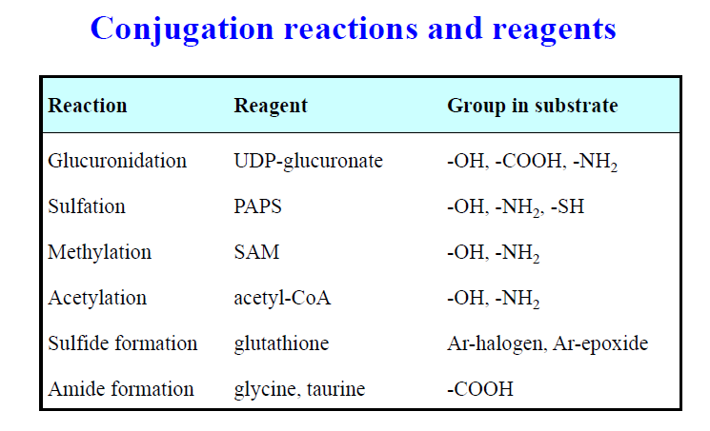

Slide 34
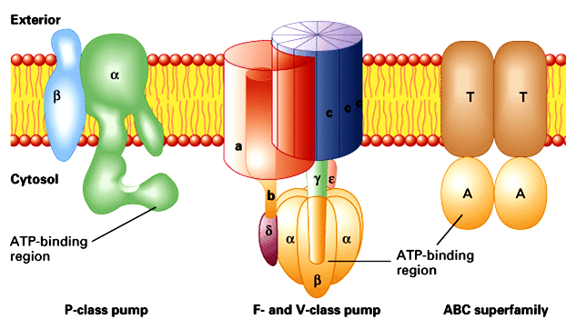
Excretion of xenobiotics from cell
primary active transport – needs energy: ATP hydrolysis
special ATP-ases called ABC (ATP binding cassettes) localized in cell membranes, export xenobiotics from cells into ECF
MRP (multidrug resistance proteins) – in increased expression, they cause the resistance towards medicines
Notes:
Types of ATPases
P-type (Ca and Na/K pumps)
Asp phosphorylation
10 transmembrane domains
F-type (Proton pumps)
Multisubunit complexes
Reversible
ABC (ATP binding cassettes)
Mechanism unknown

